Slide 1
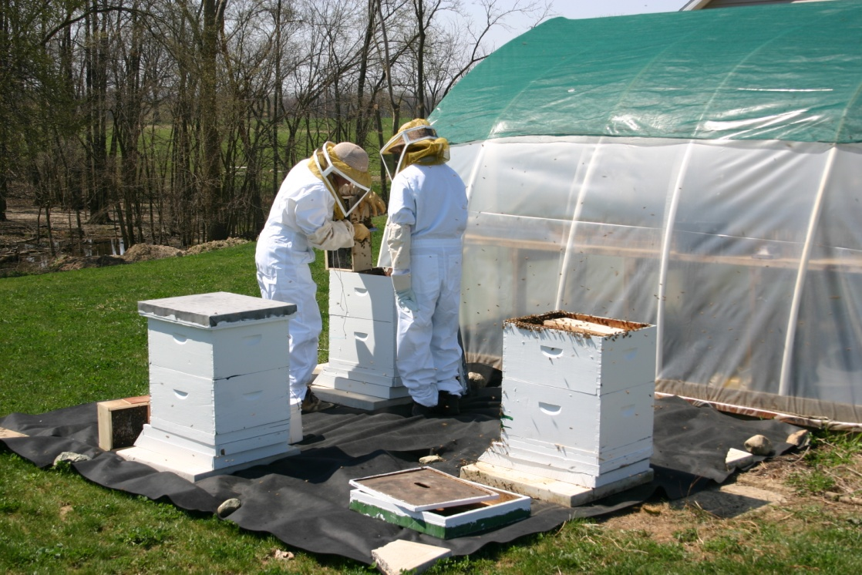
HOW TO START YOUR BEEHIVES
Packages, nucs, swarms, overwintered hives….

Slide 2
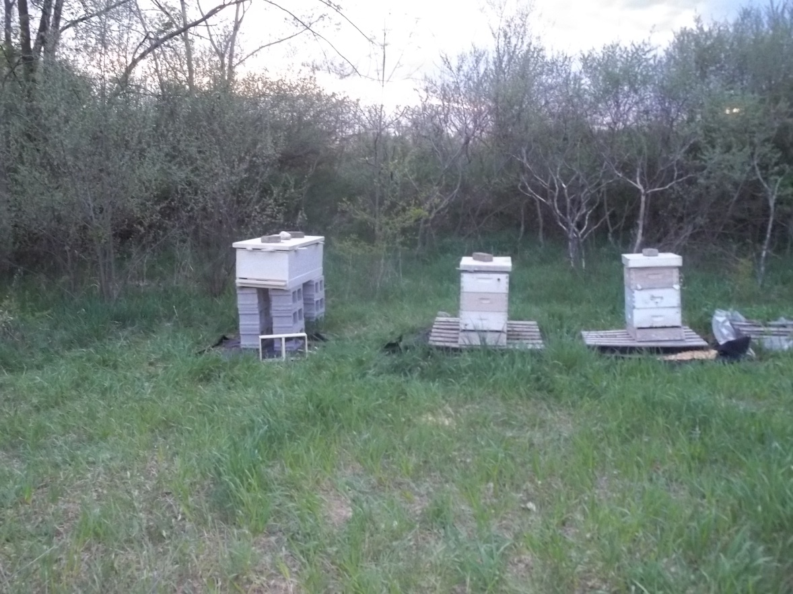
Just like in Real Estate…Location, location, location

Slide 3
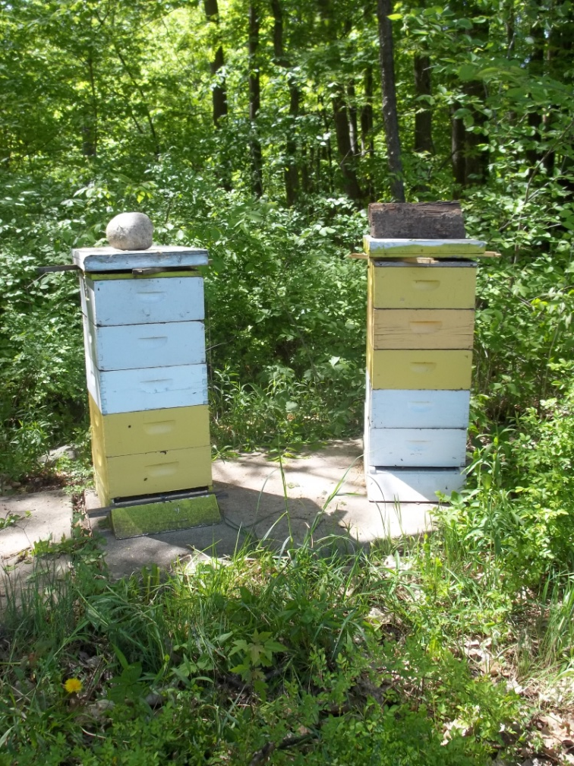
Preparing your equipment for new bees…

Slide 4
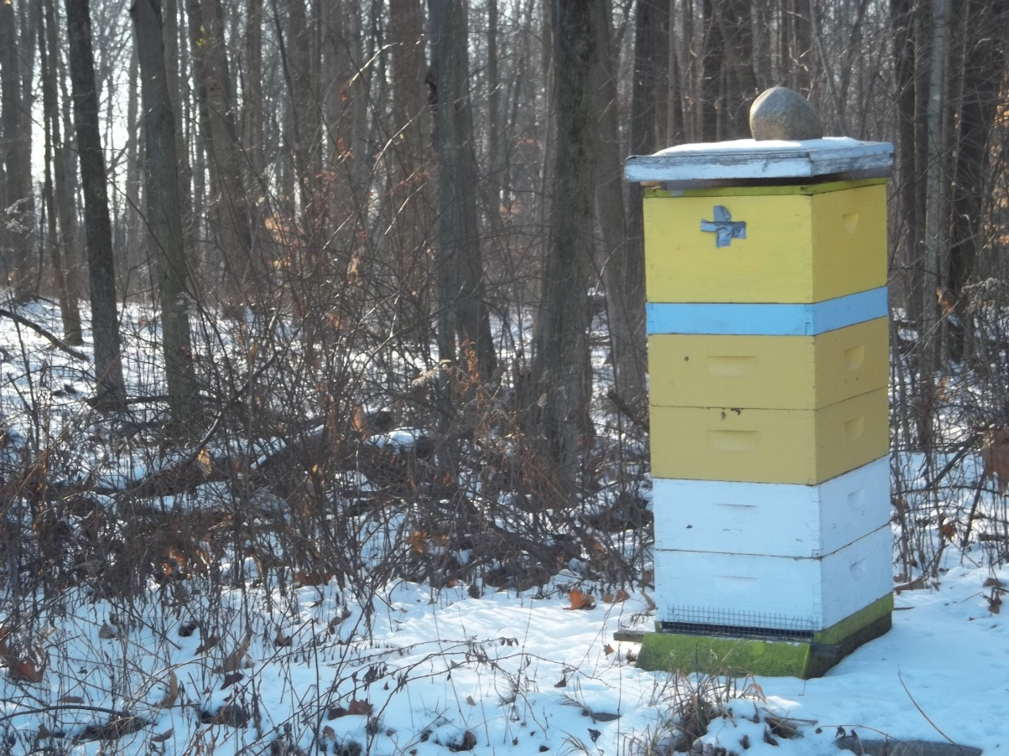
How to clean and prepare a dead-out for new bees…

Slide 5
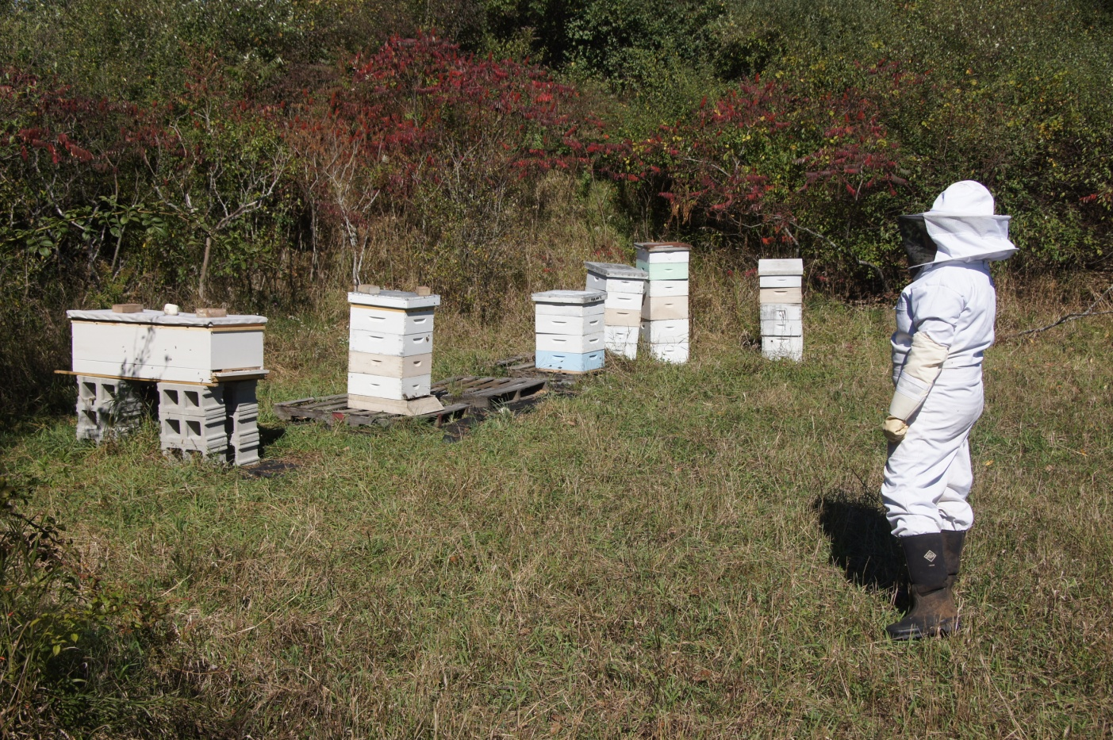
Think about preparing for winter right now…

Slide 6
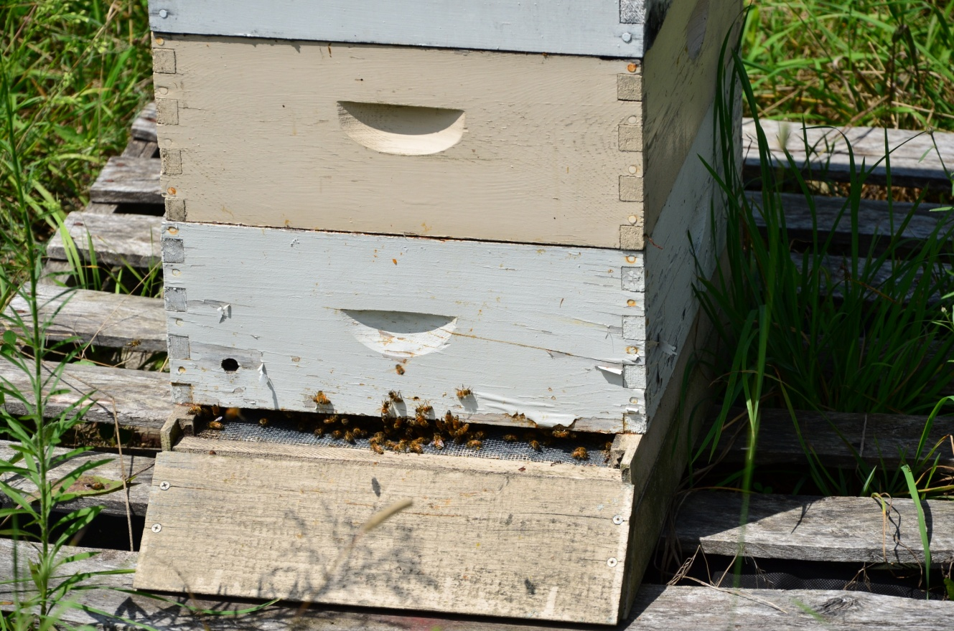
Preparing new equipment for new bees…

Slide 7
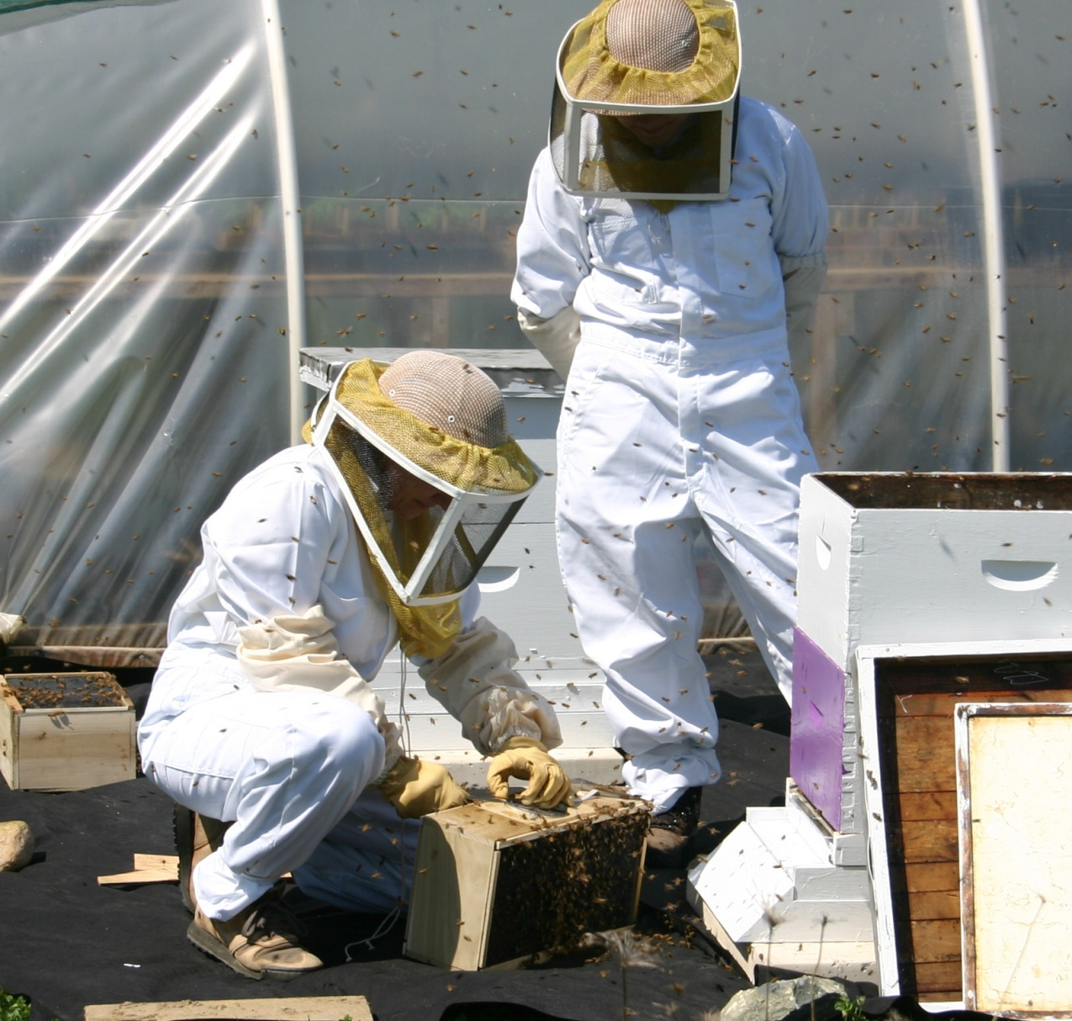
April 16, 2005 – What is wrong with this picture?

Slide 8
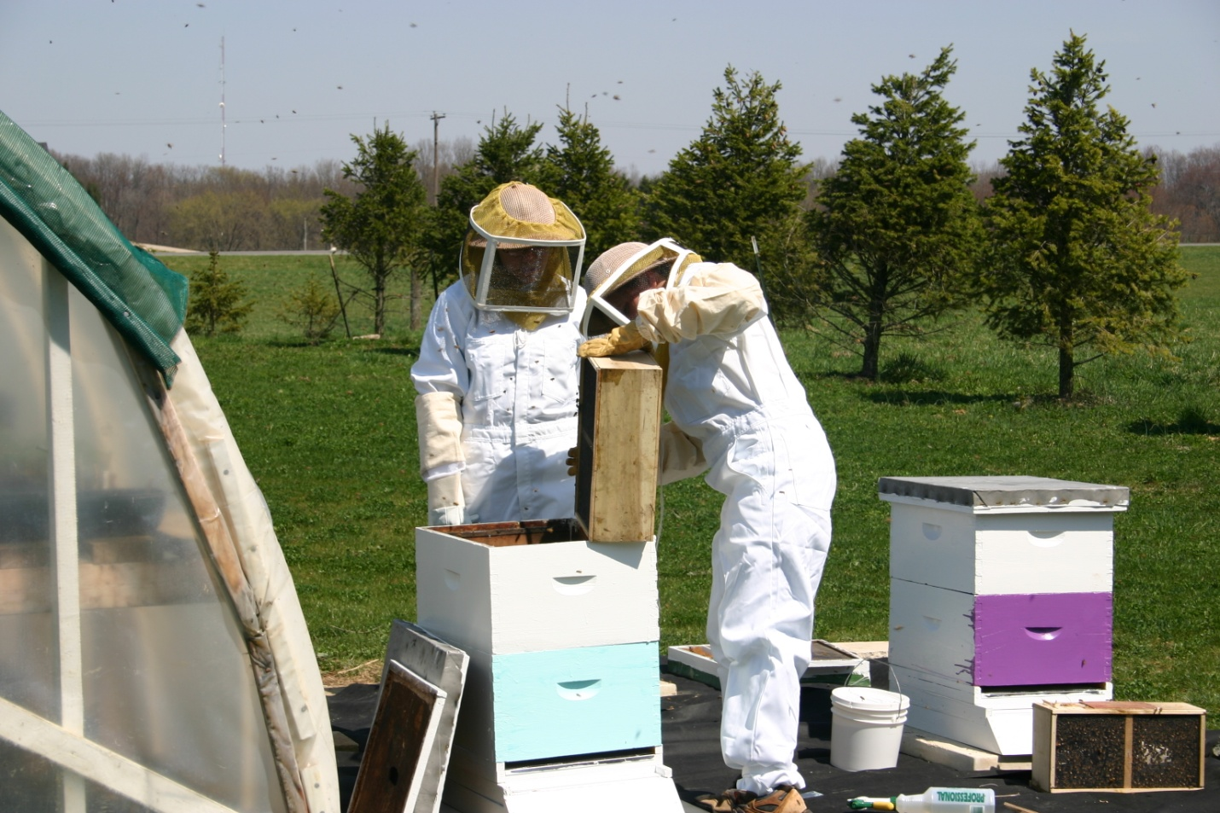
Problem #1 – bright sunny afternoon

Slide 9
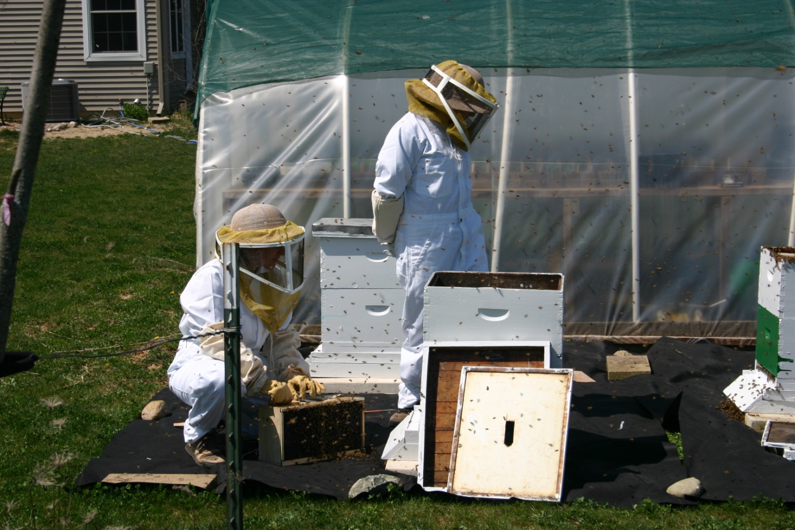
Problem #2 – Two hives opened at once

Slide 10
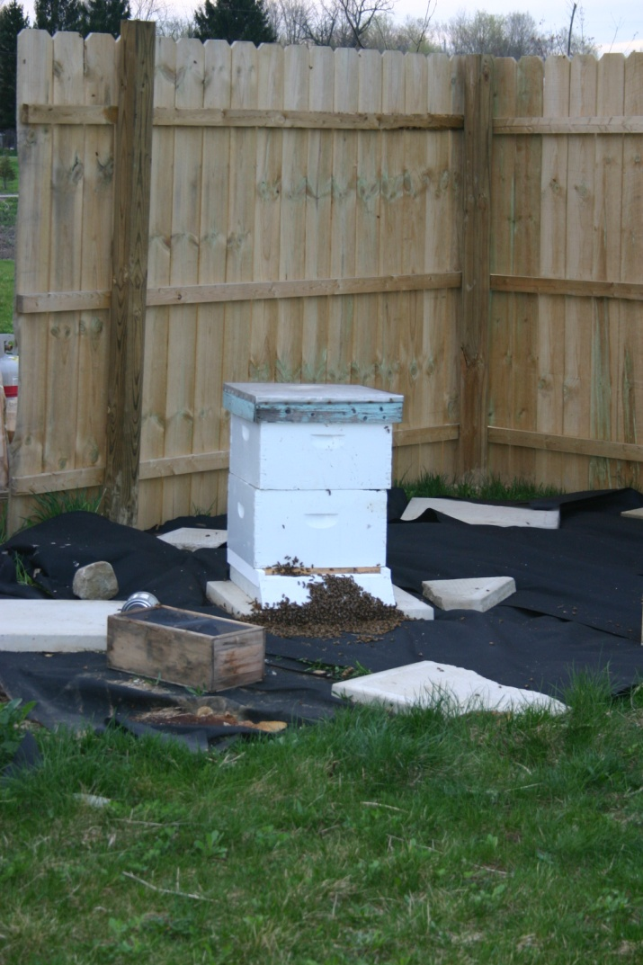
April 15, 2006 – What did we learn?

Slide 11
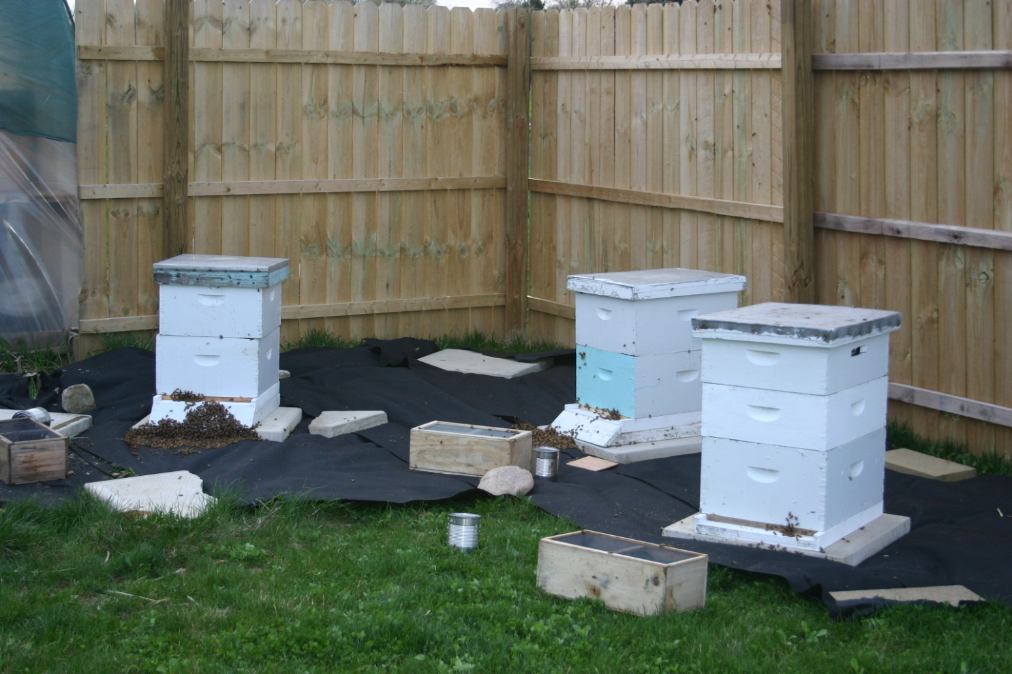
One hive at a time, dump most of the bees at the entrance, with the queen inside. Notice the lids are on!

Slide 12
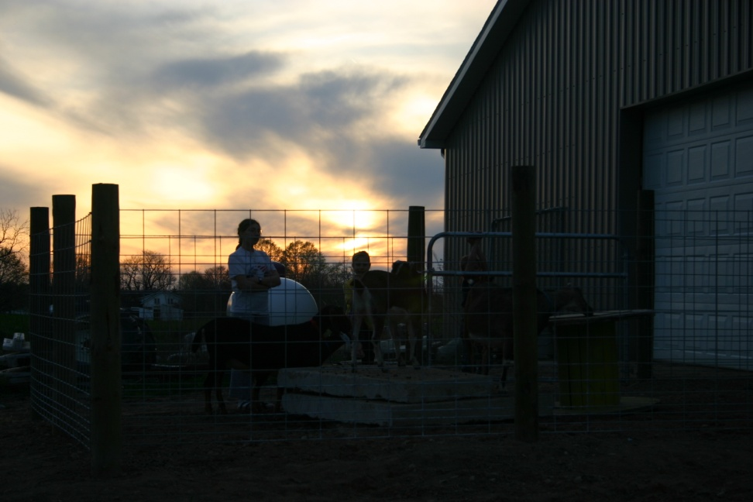
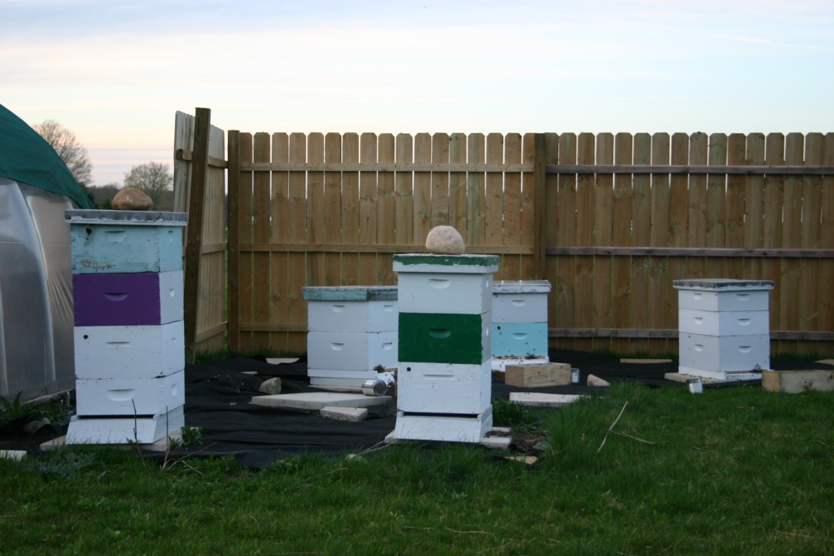
These pictures were taken at the same time – notice the time of day, sunset, much better for installing packages. There are no bees flying in the air this time!

Slide 13
In 2007 we had to install packages in below freezing temps.. I don’t have a picture of that, so I will explain.

Slide 14
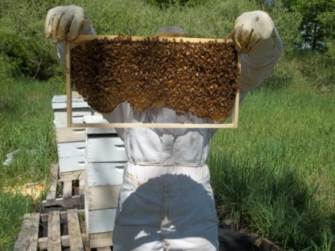
May 16, 2013
It has been nine days since we installed the package in the Long Langstroth hive. It was a beautiful day. We went out to the club apiary and added a super to each of the splits from the overwintered hive so they have plenty of room. They looked great and had a lot of bees. Now, for the moment of truth, to see how the bees are drawing out the foundationless frames in our Long Langstroth hive. We put two frames of drawn comb in with one empty frame in front, so frame #1 is foundationless, #2 and #3 are drawn comb, #4 is foundationless and so are all the rest. This picture is frame #4. That is all natural comb, completely straight and in the frame! The bees have almost attached it to the bottom of the frame. From the top, it looks exactly like comb built from foundation. Frame number one is almost as full. Frame #5 is half full, so is six and they have started on #7. We did not add any sugar water to this hive, they are doing all this on natural forage.

Slide 15
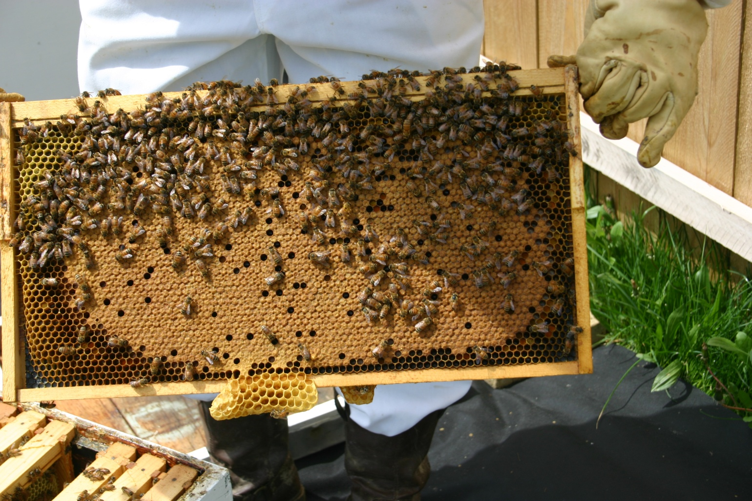
May 3, 2006, these were installed April 15, 2006. Nice brood pattern.

Slide 16
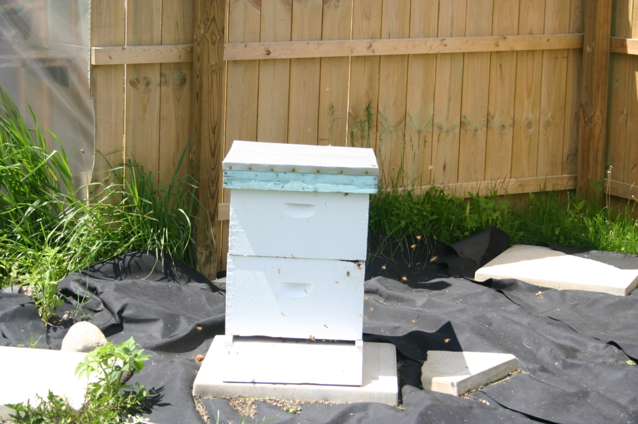
May 19, 2006, now we have added a second brood box, sugar water is removed by now.

Slide 17
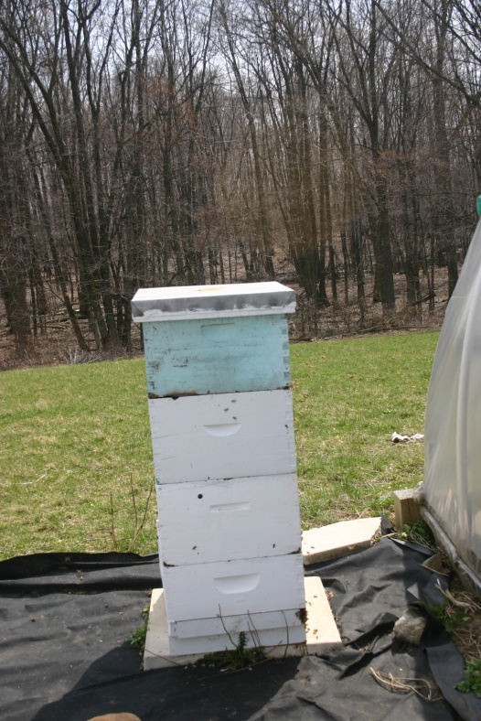
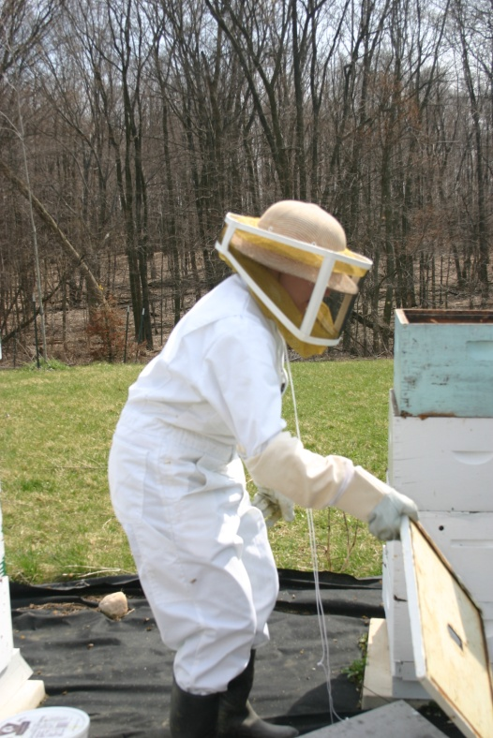
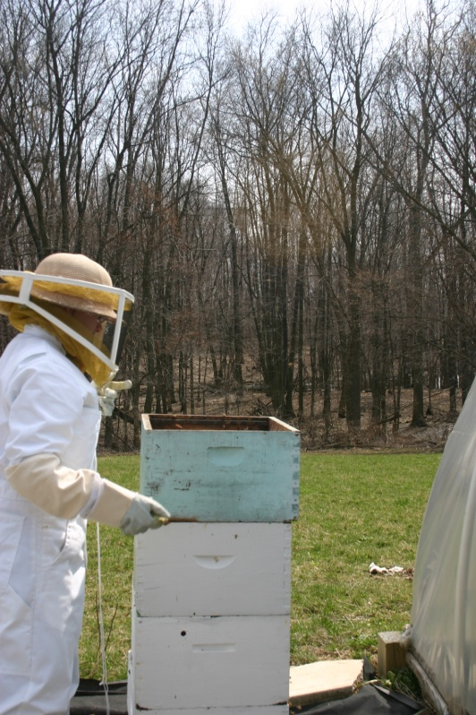
Wait until the daffodils bloom to check overwintered hives!

Slide 18
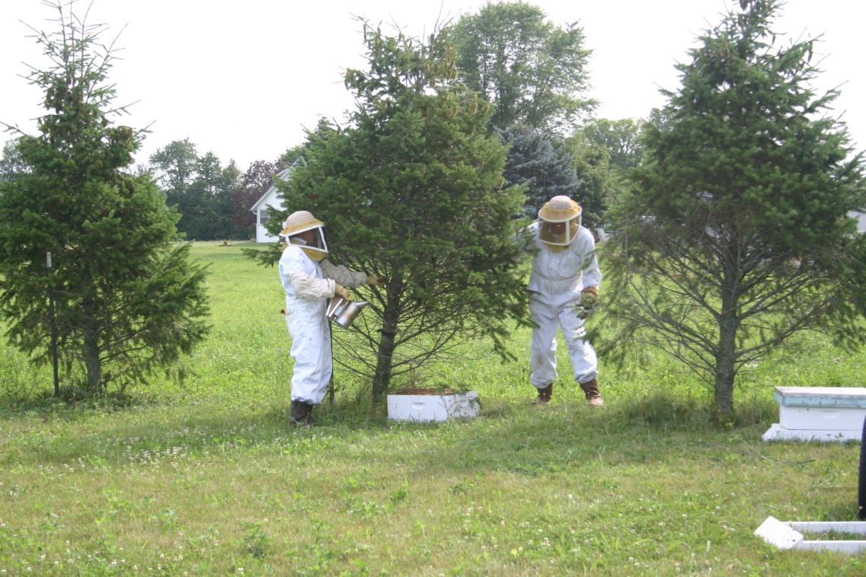
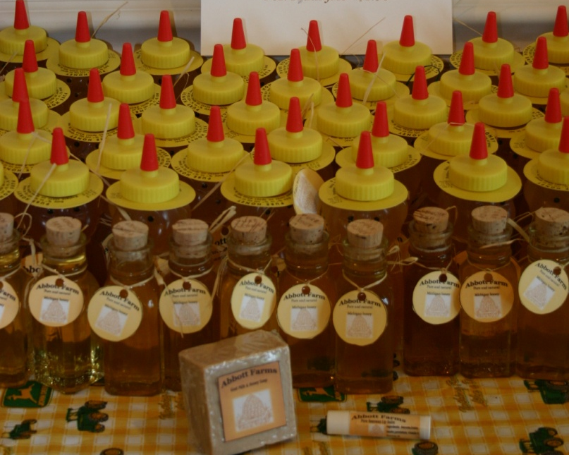
Swarms in July – probably the overwintered hives – but we did get honey!

